Slide 1

Welcome

Slide 2
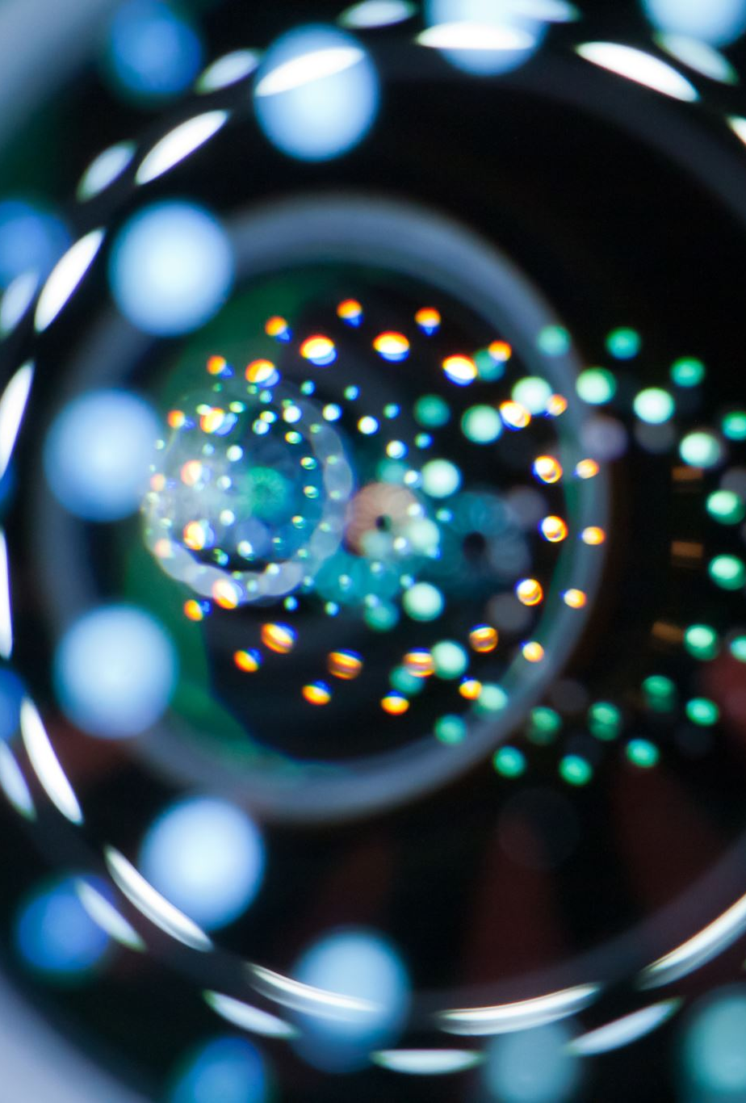
CS542 Computer Vision
Dr. M. Irfan uddin

Slide 3
Course Contents
Introduction
Image formation
Image Processing
Model fitting and optimization
Deep Learning
Recognition
Motion estimation

Slide 4
Grading
Assignment 20%
Mid Term 30%
Final Exam 50%
75% attendance is required

Slide 5
Acknowledgement
Computer Vision: Algorithms and Applications by Richard Szeliski https://szeliski.org/Book/
Introduction to Computer Vision by Noah Snavely
PyImageSearch Gurus Course
Introduction to Computer Vision by Mubarak Shah

Slide 6
Contact me
Email: irfanuddin@kust.edu.pk
WhatsApp:
0335 57 64514

Slide 7
Acknowledgement
Slides from the course Computer Vision: Algorithms and Applications by Richard Szeliski https://szeliski.org/Book/ will be used with slight modifications.

Slide 8
Acknowledgement
Slides from the course Deep Learning for Computer Vision by the University of Michigan will be used with slight modifications. Details of the course is given at https://web.eecs.umich.edu/~justincj/teaching/eecs498/WI2022/

Slide 9
Course Contents
To download the material for this course please visit https://github.com/mirfanud/Spring2024

